Slide 1
History of beer
Sandbridge beer club

Slide 2
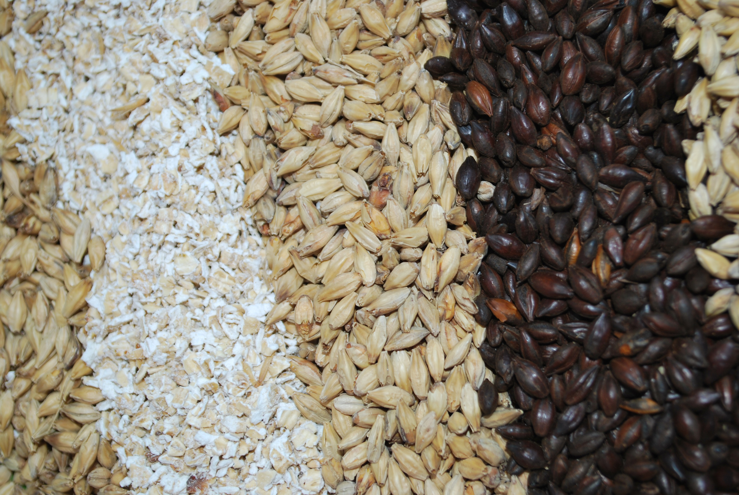
What is beer?
Any alcoholic beverage that is produced from the fermentation of grains.
Grains used in beer can include:
Barley
Wheat
Rye
Oats
Rice

Slide 3
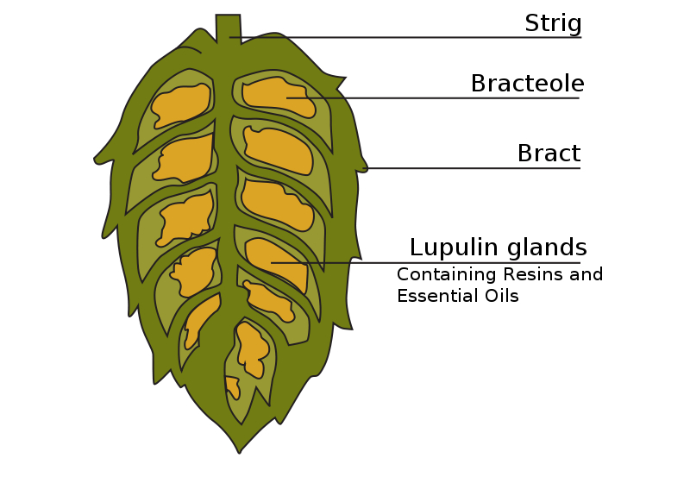
Hops
Hops came into popular use in Europe around 1000 AD.
Brewers who made Gruit were known as “Red Beer” Brewers, while brewers who made “White Beers” used hops.
Today there are hundreds of varieties of hops available to both commercial and homebrewers alike.

Slide 4
Yeast
(Saccharomyces cerevisiae)
Known as “sugar-mold” or “sugar-fungus”
Brewers make wort, not beer.
Yeast metabolizes fermentable sugars, such as malted barley, creating ethanol and carbon dioxide, which then makes beer.
Yeast used for the brewing of ales is known as “top fermenting yeast”.
Yeast used for the brewing of lagers is known as “bottom fermenting yeast”.
Yeast can be reused and many breweries have developed their own strains, giving their beers a rather distinctive flavor profile.

Slide 5
Ninkasi: goddess of beer
The Gift of the Gods
Sumerians believed beer was thought to have healing and elevating qualities which could improve the lives of those who consumed it.
Ninkasi’s Hymn, an ancient brewing recipe, was thought to have been sung while preparing the ancient brew.
Some of the first brewers were Sumerian women, priestesses of Ninkasi. This tradition of women brewers remained prevalent for millenia.
Hymn to Ninkasi
Ninkasi, you are the one who spreads
The cooked mash on large reed mats,
Coolness overcomes.
You are the one who holds with both hands
The great sweet wort,
Brewing [it] with honey and wine.
- Translated by Miguel Civil

Slide 6
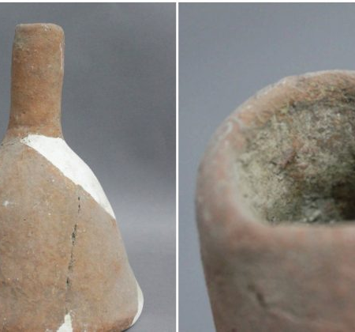
Ancient Chinese beer
Recent archaeological findings have found Chinese villagers were making beer up to 9,000 years ago.
This funnel was used around 5,000 years ago for making beer.
About 500 miles south of Beijing, researchers discovered an underground brewery dated between 3400-2900 BC.

Slide 7
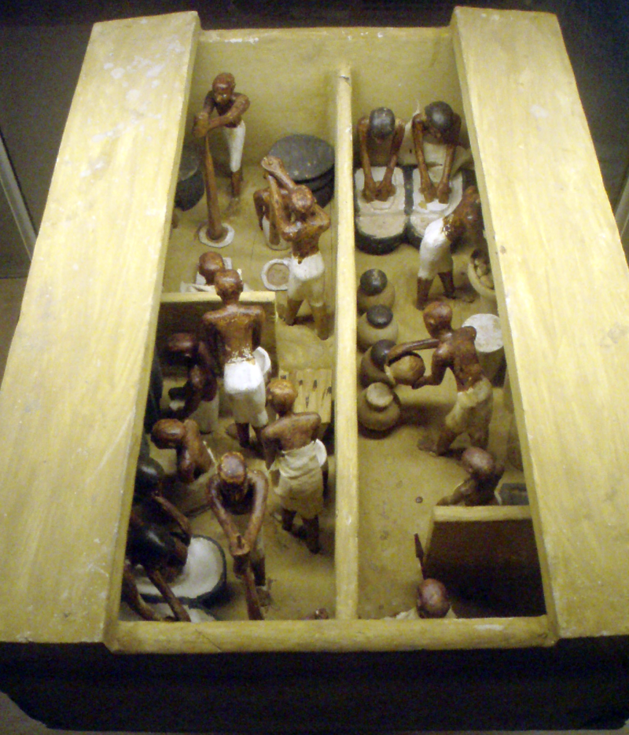
beer had many uses:
Beer was a daily ration for workers constructing the Ancient Pyramids of Giza. They relied on it for nutrition and refreshment.
Beer was used in religious ceremonies over thousands of years.
Beer was also used in trading throughout the ancient world.
(Pictured) Egyptian Bakery & Brewery, Circa 2000 BC

Slide 8
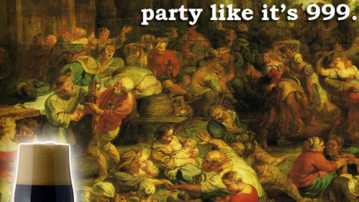
gruit
Prior to the now widely accepted use of hops in beer, combinations of bittering herbs were used, such as:
Mugwort
Horehound
Heather
Yarrow
Sweet Gale
Spruce Boughs

Slide 9
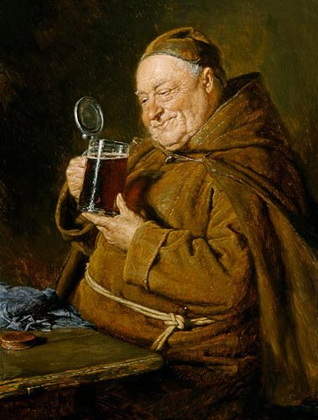
Middle ages
Brewing shifts from a primarily female industry to a male dominated industry between 500-1000 AD.
Production moves from family-oriented traditions to centralized environments such as monasteries and convents.
During Medieval times, beer was used for payment, taxation, and tithing.
In 1295, Pilsen of Western Bohemia is granted brewing rights, which set the stage for their now famous Pilsner-style Lager.

Slide 10
The first consumer protection law was written by duke Wilhelm IV of Bavaria in what year?
A. 1650
B. 1873 c. 1516 d. 1776

Slide 11
Reinheitsgebot
(Purity order)
Although there were earlier versions of the Bavarian Purity Law, it was not widely accepted until 1516.
Still the oldest known consumer protection law.
Originally listed only 3 ingredients:
Water
Barley
Hops
What is the fourth ingredient later added?

Slide 12
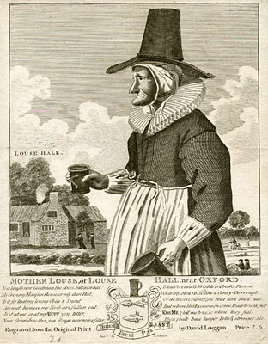
“Then put it again into the Cauldron, and boil it an hour or an hour and a half. Then put it into a Wooden-vessel to cool, which will require near forty hours for a hogshead.”
- Scotch Ale from my Lady Holmbey

Slide 13
Witch or brewster?
witches
brewsters
Big, pointy hats perfect for cackling
Rode on broomsticks at night
Cauldrons used for spells
Fire burn and cauldron bubble
It has been thought that the witch trials were a main cause for brewing to shift into the hands of men.
Alewives wore fashionable hats which allowed them to be recognized more easily in crowds.
Brooms were a sign of domestic trade and often were adorned with red bouquets.
Brewing Vessels were used over open flames as it was the best way to make beer.

Slide 14
England & north america
1612 – First commercial brewery opens in New Amsterdam (NYC)
1620 – Pilgrims land due to low beer supply
1786 – Molson Brewery is founded in Canada
1789 – James Madison proposes lower taxes on malted liquors to encourage beer production
Brewing quickly became a national pastime in the New World.
Soldiers in the Revolutionary Army received one quart of beer per day.
As non-hopped beer loses fashion, Porters climb in popularity first in England, then in America.

Slide 15
In what year was the first Oktoberfest held?
A. 1810
B. 1720 c. 1630 d. 1900

Slide 16
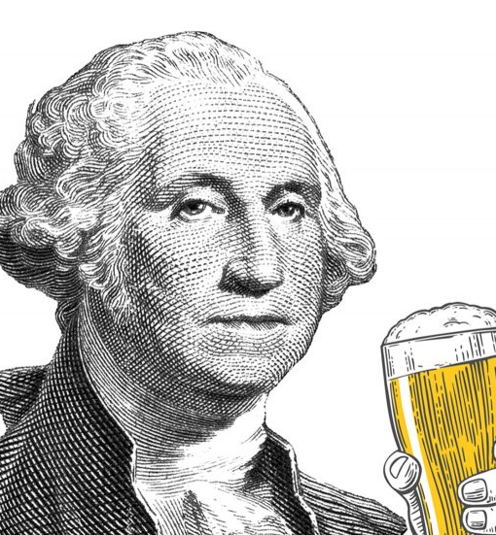
George Washington
Washington was known as an avid
homebrewer, whose favorite beer style was porter.
He brewed his own version using molasses, bran hops, and yeast.
Washington was also fond of brewing beers utilizing locally available ingredients, such as Virginia Spruce Boughs.

Slide 17
Beer is the second most popular drink in the world. What is the first?
A. Milk
B. tea c. soda d. water

Slide 18
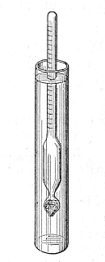
Modern history of beer
The hydrometer made it possible for brewers to accurately calculate yields of various malted barley, which produced less-expensive beer.
Today, the United States has over 5,000 breweries which produce over 200 million barrels per year.
The top three largest craft breweries (by sales volume in the US) are:
D.G. Yuengling & Son
Boston Beer Company
Sierra Nevada Brewing Company

Slide 19
Besides sipping, what is the best way to get rid of beer foam?
A. use beer foam tablets
B. use a straw c. use your finger d. drop a penny in the beer

Slide 20
thanks
Sandbridge beer club

