Slide 1
Membrane Technologies for Wastewater Treatment W. Gilbert O’Neal, Ph.D., P.E.

Slide 2
Membrane Biological Reactors (MBr)
Membrane Filtration of Activated Sludge Mixed Liquor
Eliminates clarifiers
Removes solids and turbidity from effluent
Reduced footprint
Tolerates
High SRT, MLSS
Filamentous Bacteria

Slide 3
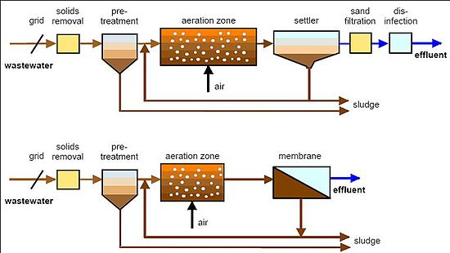

Slide 4
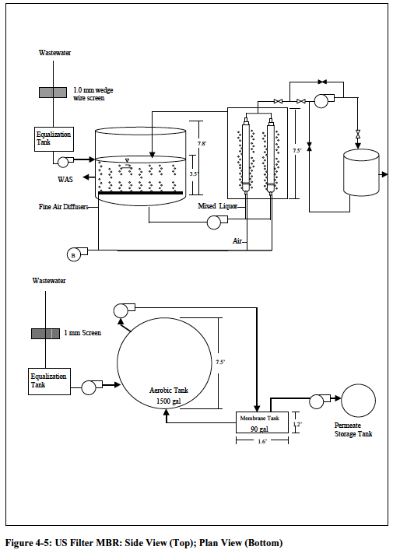

Slide 5
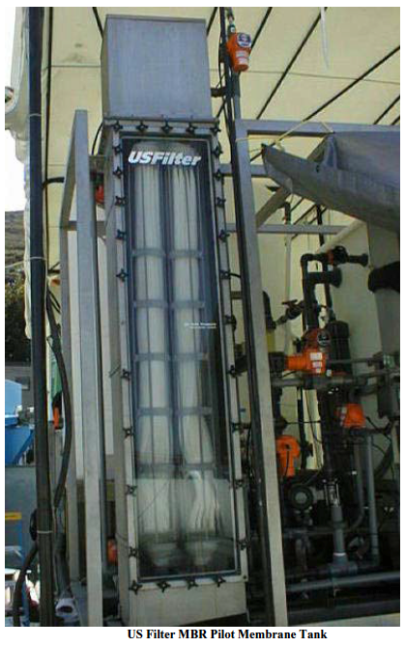

Slide 6
ZeeWeed MBr
https://www.youtube.com/watch?v=d0bcPBjNz2g
https://www.youtube.com/watch?v=H_sqYYBUZB0
https://www.youtube.com/watch?v=2R9tmlaP5Rc

Slide 7
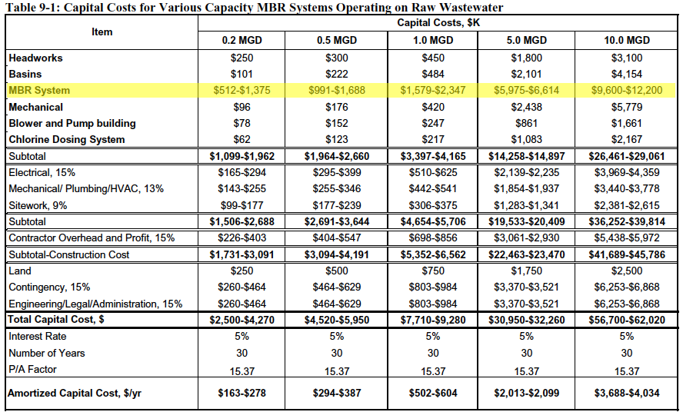

Slide 9
Zero Liquid Discharge (ZLD)
Water Reuse (90-95%)
“Dry” Residual Disposal
System Components
Biological Treatment
Chemical Treatment
Macro Filtration
Membrane Filtration (UF and RO)
Evaporation (MEE)

Slide 10
Application
Regulatory Restrictions
India
Resource Limitations
Discharge Limitations
Sustainability Goals

Slide 11
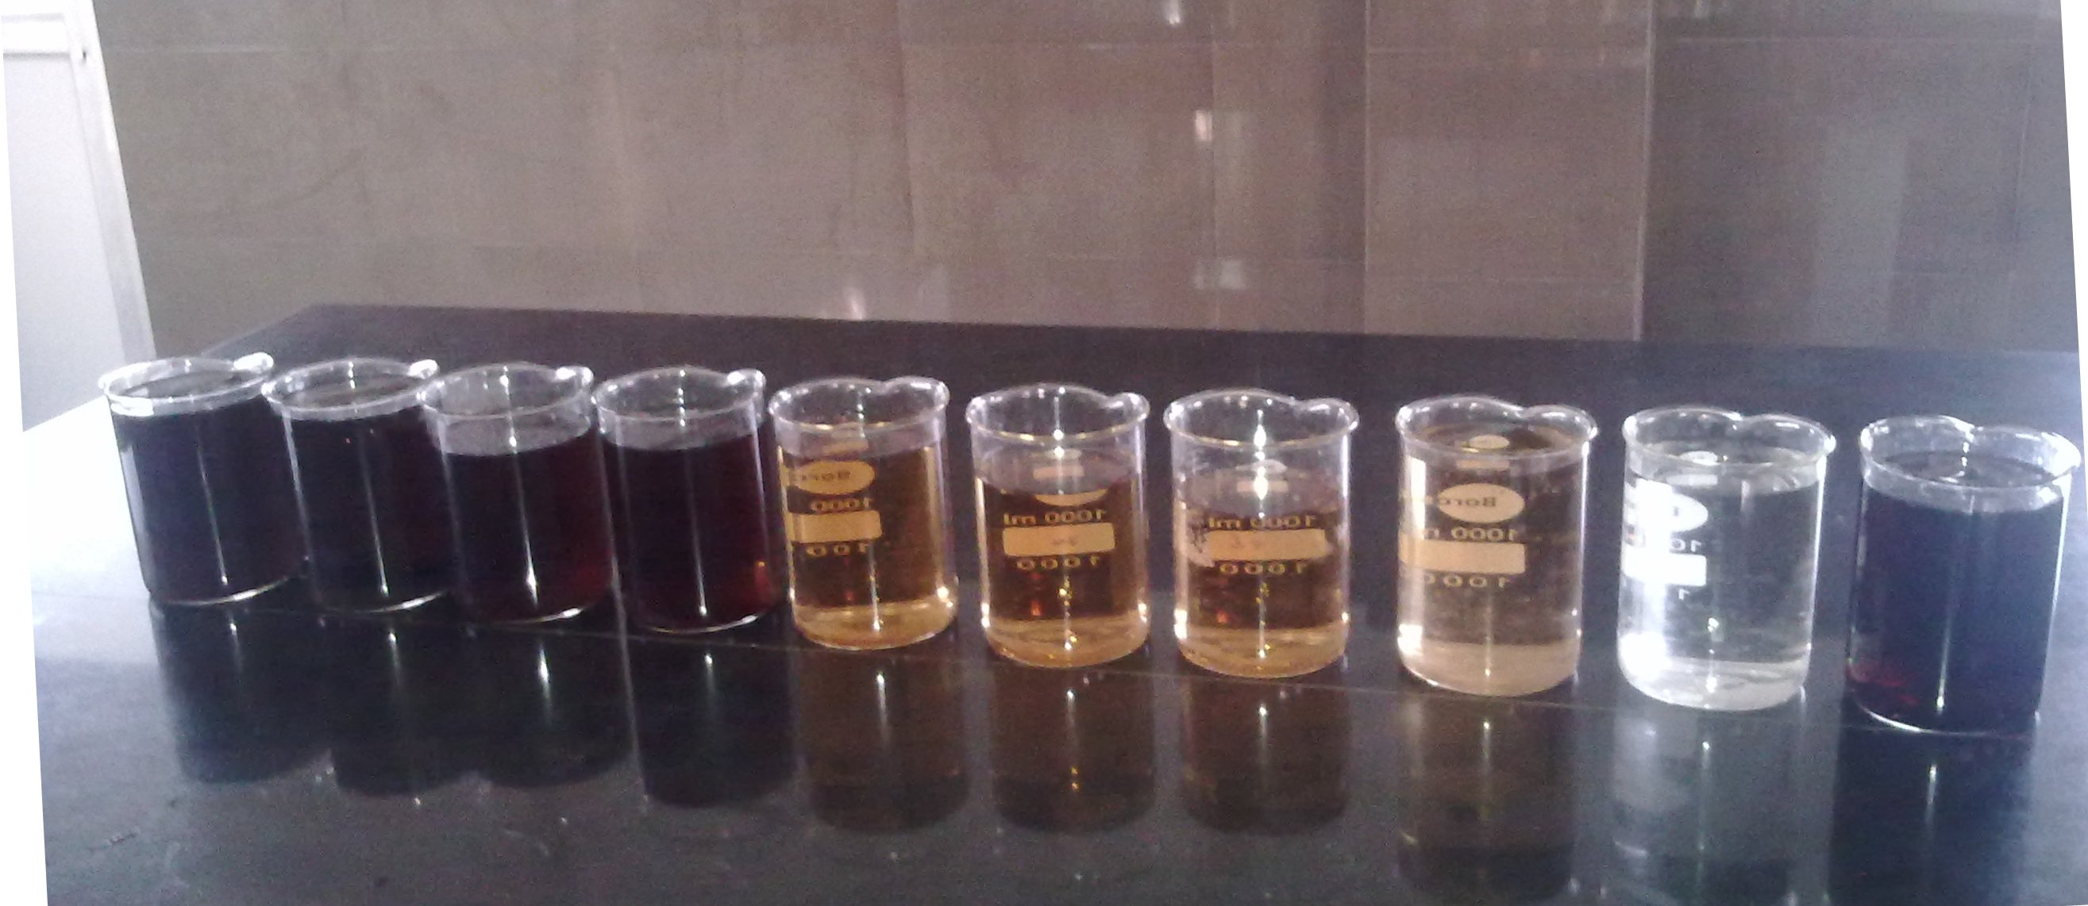
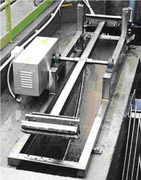
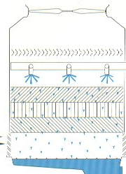
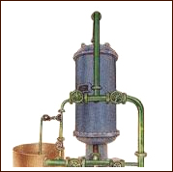
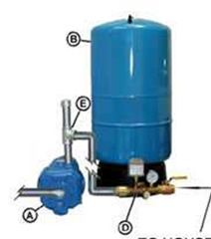
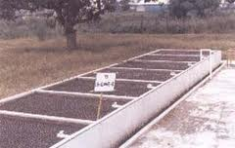
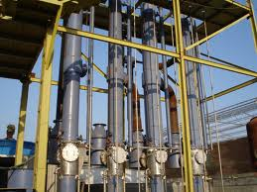
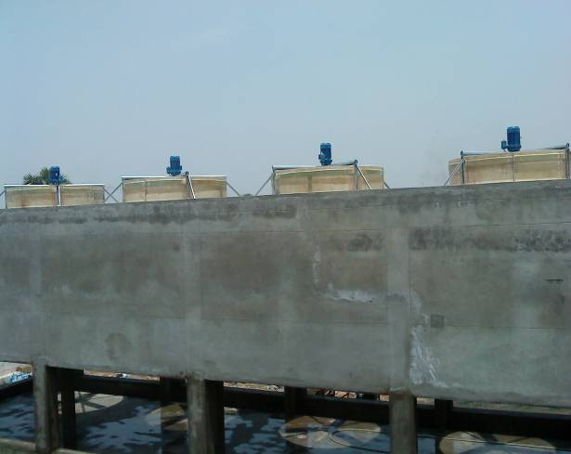
ZLD PLANT FLOW DIAGRAM
Influent
Pump
Filter
Heat Exchanger
Equalization
Cooling Tower
Secondary Clarifier
UF
Quartz Filter
Biological Oxidation
Permeate to process – 93%
De-carbonator
3- stage RO
Sludge Thickener
Filter Press
Softener
Resin Filter
Reject - 7%
Sludge storage
Solar Pond
MEE
Air Evaporator

Slide 12
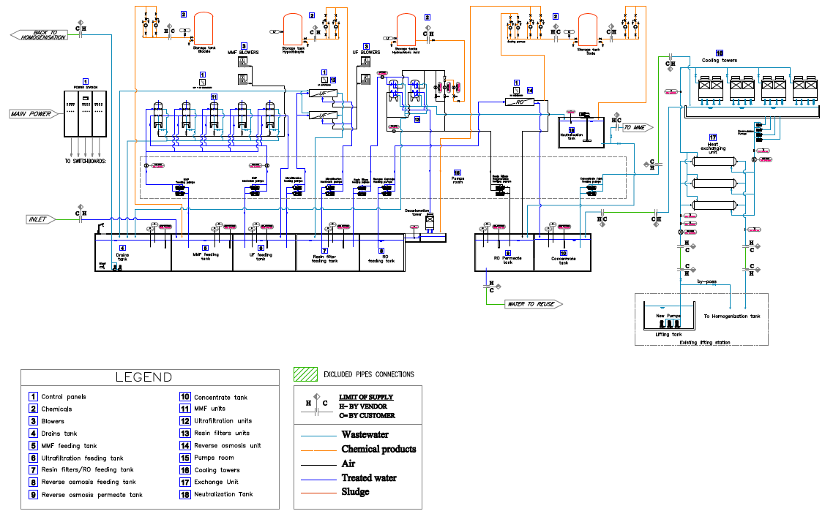
ZLD Schematic

Slide 13
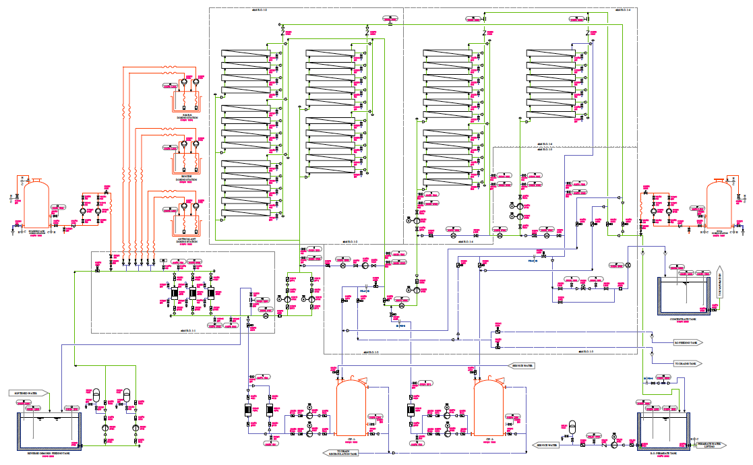
RO System Detail

Slide 14
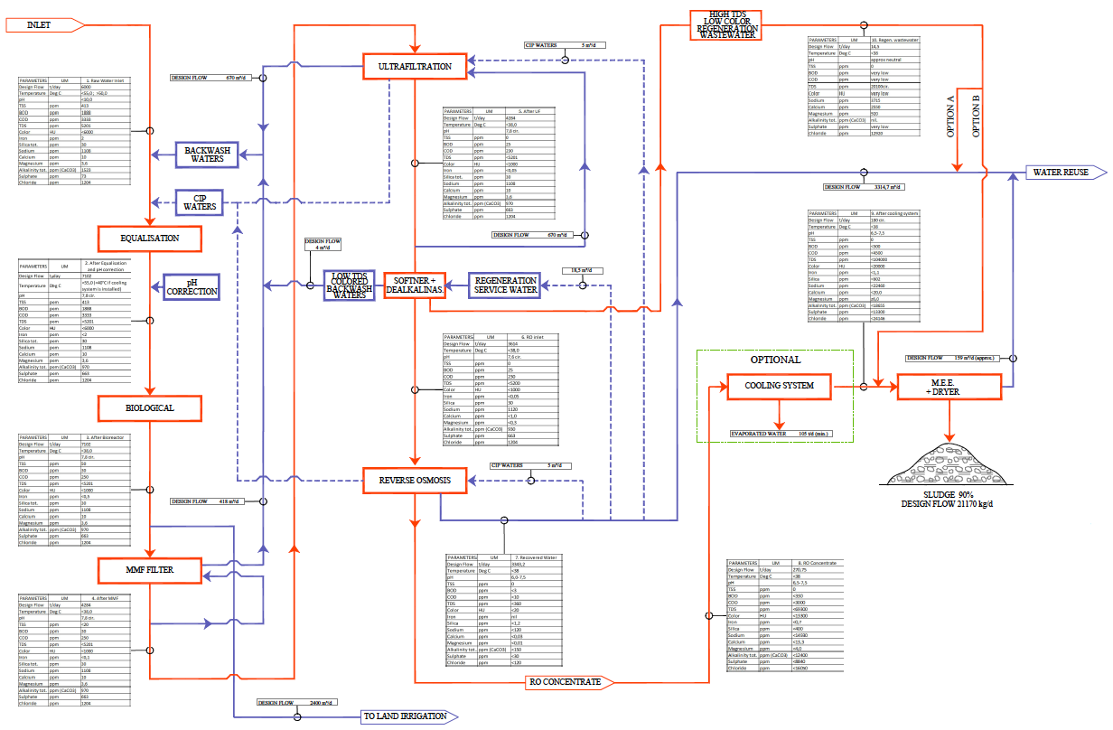
ZLD Mass Balance

Slide 15
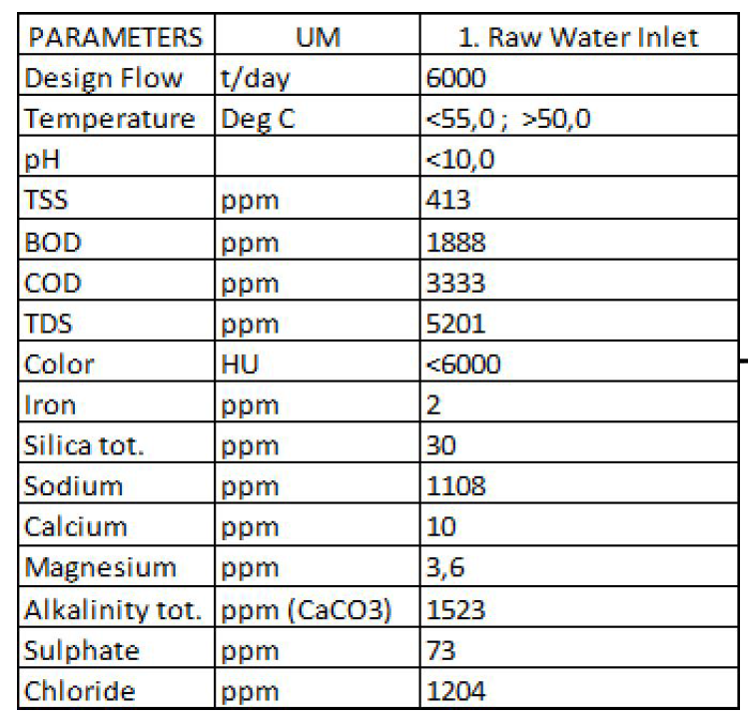
Influent Characteristics
1.6 mgd

Slide 16
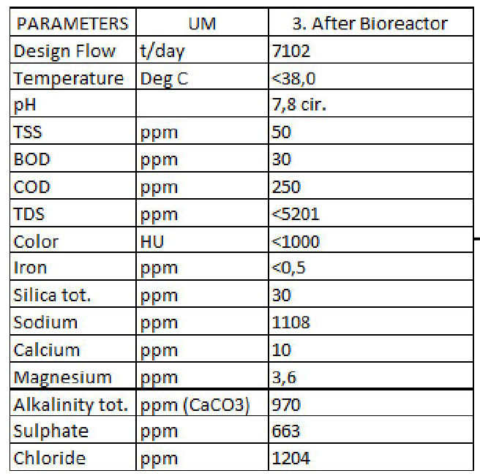
Biological Effluent

Slide 17
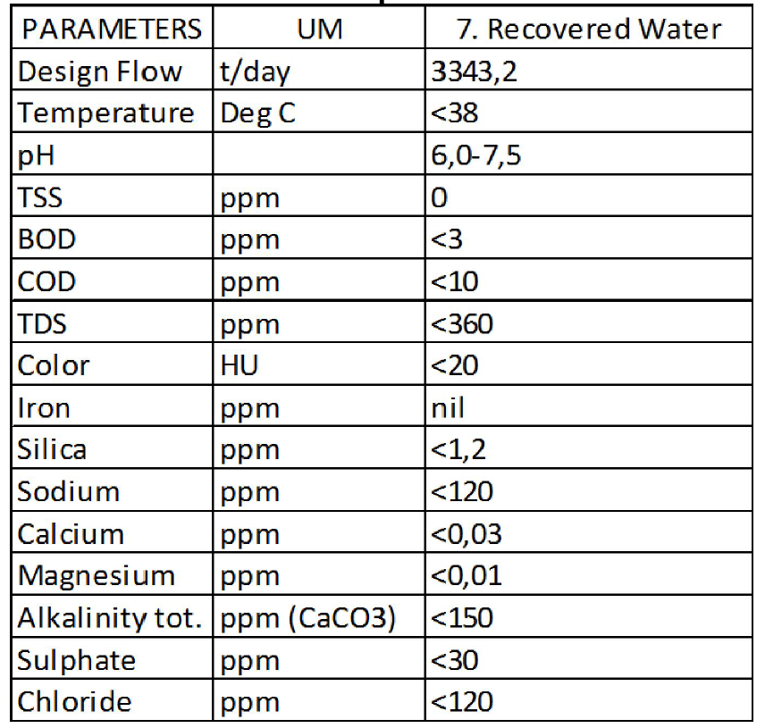
RO Permeate

Slide 18
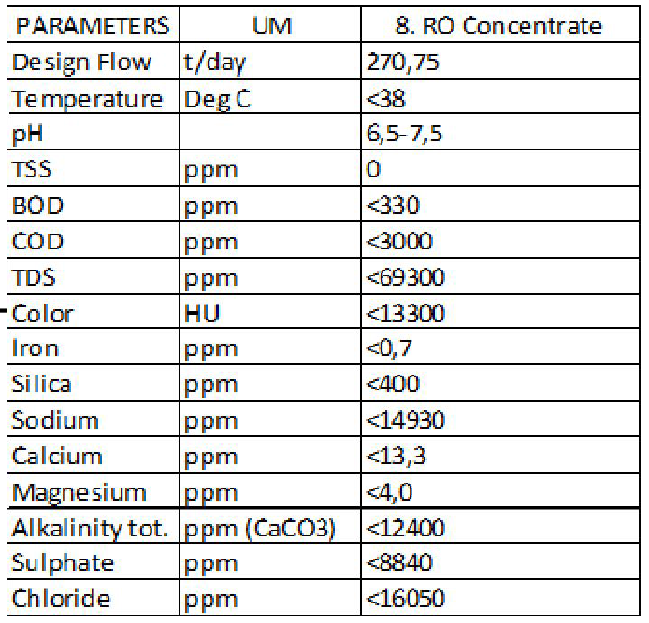
Reject Water
71,600 gpd

Slide 19
ZLD Cost
100,000 GPD System
Capital Cost: $2,000,000
Operating Cost: $16/1000 gal.

