Slide 1
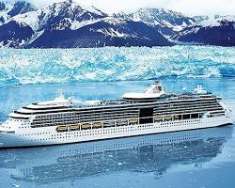
45TH REUNION ALASKAN CRUISE
Saturday, June 19th – Arrive in Seattle: Meet N Greet
Sunday, June 20th - Tour Seattle - Sneaker Party
Monday, June 21st – All Aboard, Depart for Alaska
Monday, June 28th – Return, Disembark, Fly Home
Celebrating together on a scenic adventure
Notes:
Image source: AI-generated

Slide 2
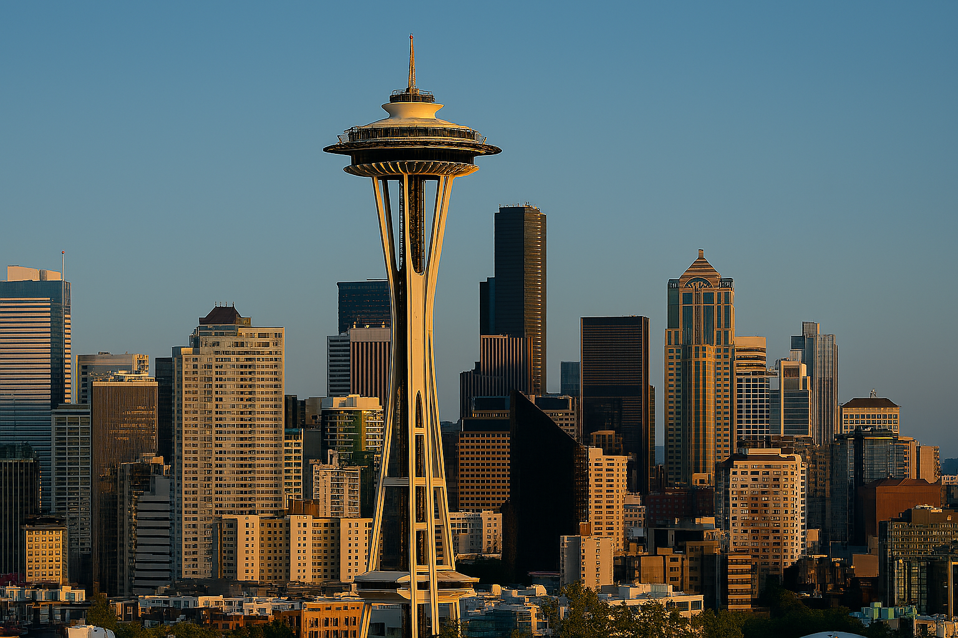
AGENDA
Saturday
Arrival in Seattle: Evening Meet & Greet
Sunday
Exploring Seattle: Daytime Tour Activities
Class Reunion Sneaker Party Experience
Monday
Cruise Departure and Onboard Experience
Notes:
Arrival in Seattle and Welcome Gathering
Exploring Seattle: Daytime Tour Activities
Class Reunion Party Experience
Cruise Departure and Onboard Experience
Image source: AI-generated

Slide 3

Commemorative. 45th Runion Sneaker party
School colors, banners, photo walls, and memorabilia-style centerpieces create instant recognition and belonging.
Mix graduation-year favorites with current hits to spark nostalgia while keeping energy high for all guests.
Event ambiance, which shows with lighting and background music can significantly influence engagement and overall enjoyment.
Notes:
Décor themes often reflect school colors and memorabilia, using banners, photo walls, and centerpieces that evoke shared history. Music selections typically blend popular hits from graduation years with contemporary tunes to balance nostalgia and enjoyment. Studies on event ambiance find that sensory elements such as lighting and background music strongly influence attendee mood and engagement.
Image source: AI-generated

Slide 4
Royal Caribbean
Anthem of the Seas
7-Night Alaska Cruise
June 21–28, 2027
Seattle, Washington
CRUISE DEPARTURE
ALL ABOARD
AIN’T NO STOPPING US NOW,WE’RE ON THE MOVE…
Notes:
Saturday Breakfast and Pre-Cruise Arrangements, Boarding Process and Cruise Itinerary Overview, Setting Sail for Alaska: What to Expect on Board

Slide 5
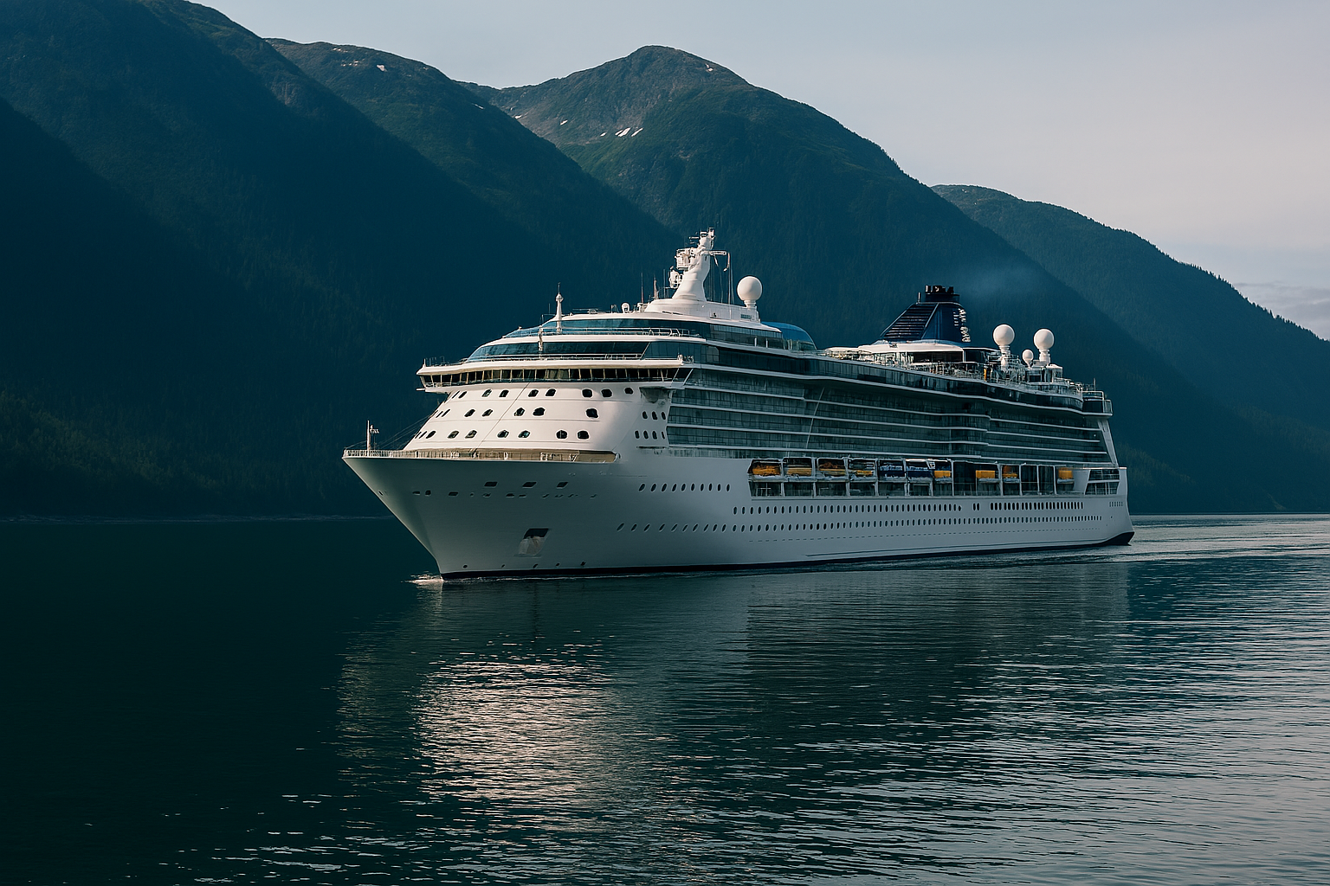
SETTING SAIL
ALL ABOARD
Comfortable cabins and multiple venues designed for unhurried meals.
Wildlife and geography talks, plus easy spaces for reading, photography, and rest.
Glaciers, Crabs Legs and Marine life deliver high satisfaction—pack layers and outdoor gear for shifting weather.
Notes:
Passengers can expect comfortable cabins, multiple dining venues, and a variety of onboard activities including lectures on Alaskan wildlife and geography. The journey features stunning views of fjords, glaciers, and marine life, with opportunities for photography and relaxation alike. Cruise lines report high guest satisfaction rates for Alaska routes due to scenic variety and enriching excursions. Weather can be variable, so layering and outdoor gear are advised.
Image source: AI-generated

Slide 6


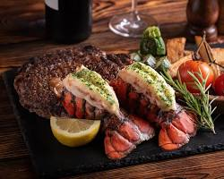
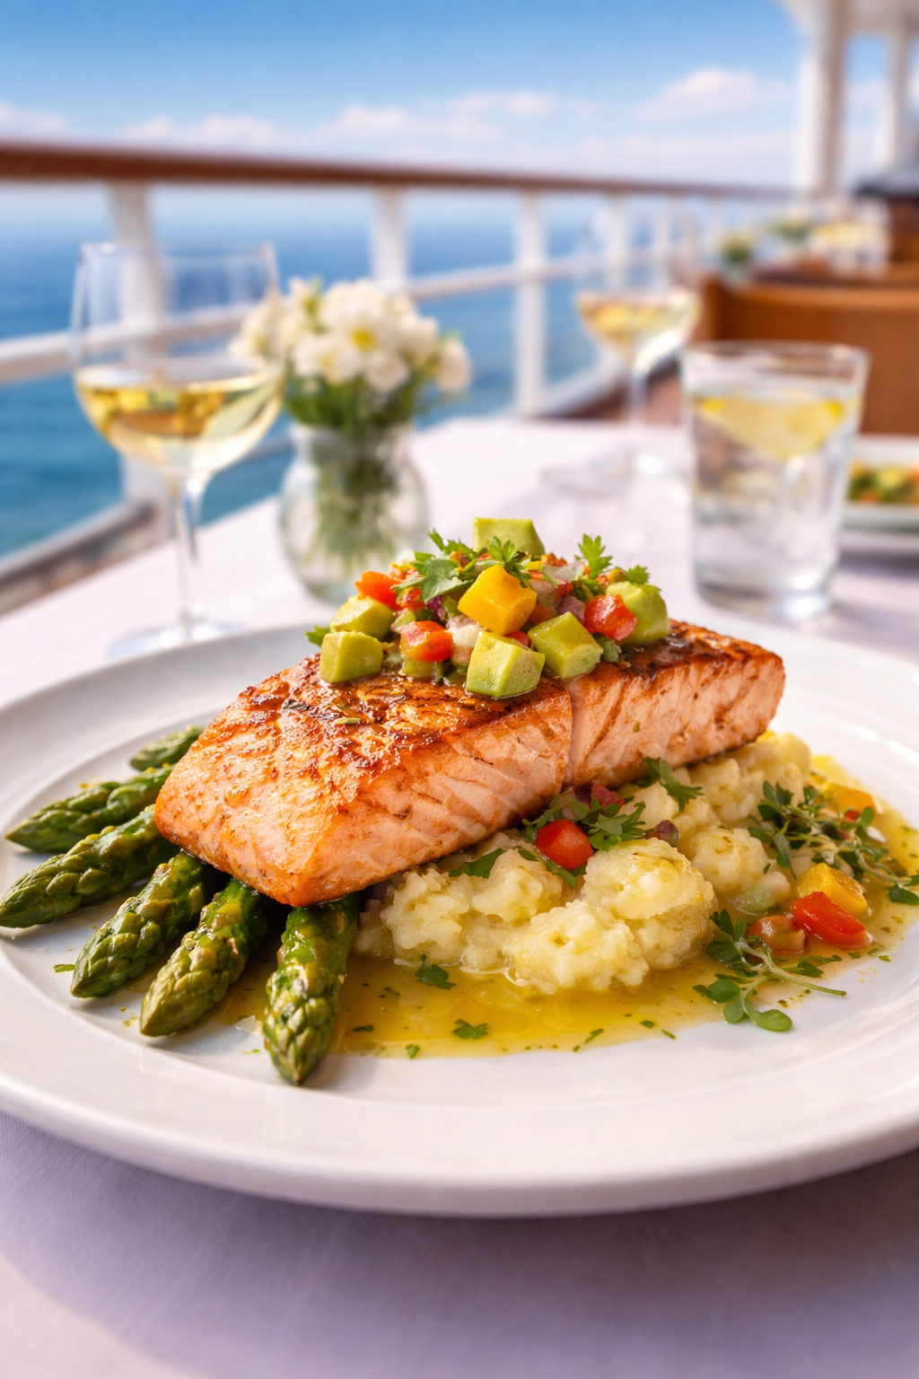
HOME OF THE KING CRAB LEGS

Slide 7
🛳 Itinerary
Mon, Jun 21, 2027 – Seattle, Washington
Boarding · Departs 4:00 PM
Tue, Jun 22, 2027 – Cruising
Day at Sea
Wed, Jun 23, 2027 – Sitka, Alaska
9:30 AM – 5:00 PM · Docked
Thu, Jun 24, 2027 – Skagway, Alaska
7:00 AM – 8:00 PM · Docked
Fri, Jun 25, 2027 – Endicott Arm & Dawes Glacier (Scenic Cruising)
5:00 AM – 9:30 AM · Cruising
Fri, Jun 25, 2027 – Juneau, Alaska
1:00 PM – 8:00 PM · Docked
Sat, Jun 26, 2027 – Cruising
Day at Sea
Sun, Jun 27, 2027 – Victoria, British Columbia
5:00 PM – 10:00 PM · Docked
Mon, Jun 28, 2027 – Seattle, Washington
Arrival 6:00 AM · Disembarkation
Notes:
This reunion and Alaskan cruise adventure brought us closer as classmates, blending joyful reunions, exciting exploration of Seattle, festive celebrations, and the breathtaking journey to Alaska. Let’s treasure these shared moments and look forward to future gatherings filled with friendship and discovery.

Slide 8
Deposit & Rates
💵 Rates (Per Person | Based on 2 Guests in the Cabin)
Inside Guarantee Cabin: Location chosen by the cruise line – $1,316 per person
Unobstructed Ocean View Balcony: $1,949 per person
All cabins will get at least $100.00 onboard credit.
💰 Deposit & Payment Details
Deposit: $500 per cabin (non-refundable)
Final Payment Due: March 23, 2027

Slide 9
🛂 Travel Requirements
Passports are required for all travelers on this itinerary.

