Slide 1


Class of 82: Summer Trip to Turks and Caicos

Slide 2


Turks and Caicos: Hotels
Blue Haven Resort
Price: $250-$1,700+ per night for standard rooms (often all-inclusive), with peak season (winter/spring) and luxury suites reaching upwards of $2,000-$3,000+ daily
Included:
Prices often include meals, drinks, and activities
Best Features: Spa and Massages

Slide 3

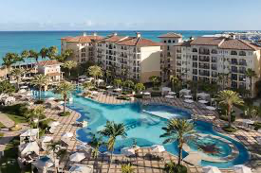
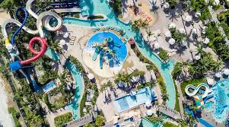
Turks and Caicos: Hotels
Beaches Resort
Price: ~$355+ Per Night (PP/PN) and kids from ~$38+ PP/PN
Included:
Prices often include meals, drinks, and activities
Best Features: 18 dining options, water sports, and live entertainment.

Slide 4
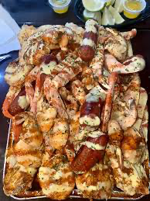
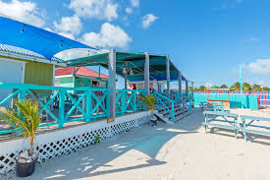
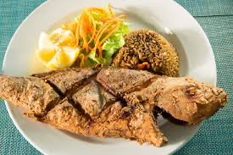
Things to do in Turks and Caicos: EAT
1.) Seafood Hub TCI
2.) Island Fish Fry (Thursday Only)
3.) Mr. Grouper
4.) Da Conch Shack
5.) Omar’s Beach Hut

Slide 5
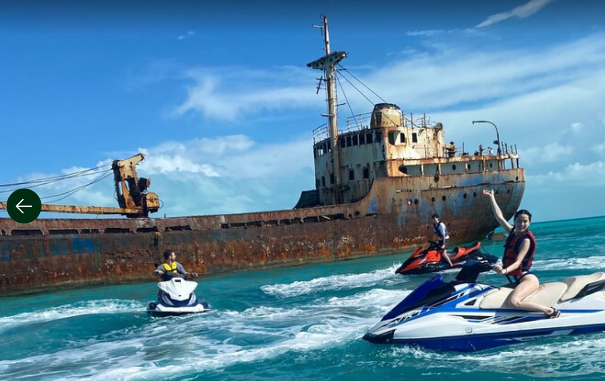

Things to do in Turks and Caicos: Activities
1.) Noah’s Arc
Transportation price: $30
Excursion Price: Catamaran Trip (Tiki Bar): $115 (alcoholic drinks included)
Duration: 4 hours
Best times to go: Sunday
Tiki Bar: $25 per drink
Activities:
- Water sports (jetski’s, floating cars, etc.)
- Open Air Tiki Bar
- Boat Rental

Slide 6
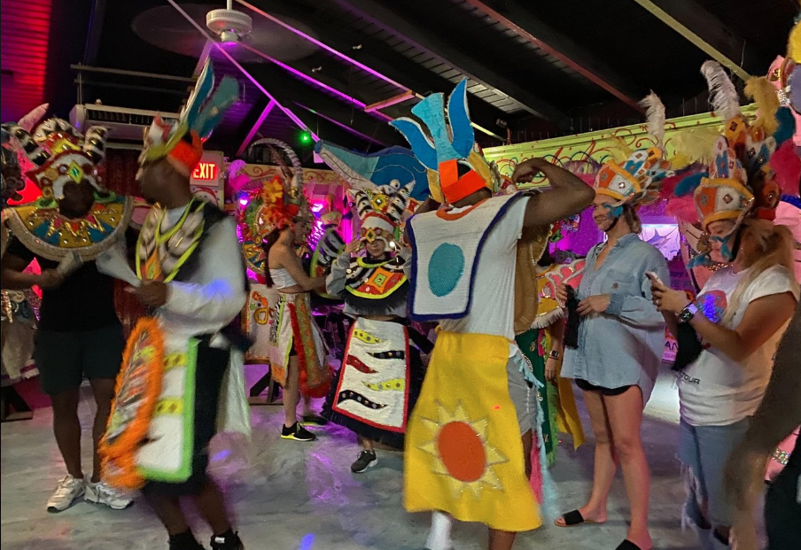

Things to do in Turks and Caicos: Activities
2.) Love Buggy Island Tour with Lunch
Excursion Price: $229
What is included:
Lunch is included in the cost of the tour
All attraction entry fees are included
Overview:
Spend half a day exploring Providenciales Island in your very own 'Love Buggy.' With this tour, see around 85 percent of the island, with stops at scenic views, hidden gems, villas, the Cheshire Hall Plantation, and more. Read more about - Love Buggy Island Tour with Lunch

Slide 7
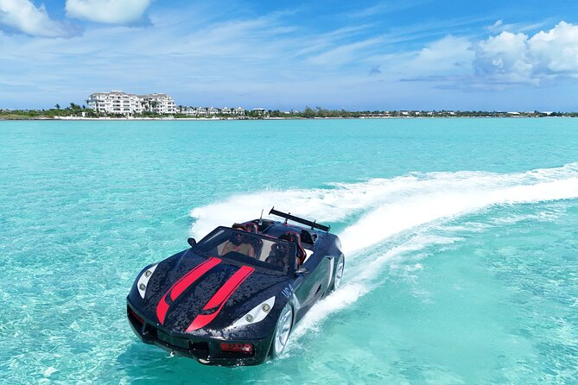

Things to do in Turks and Caicos: Activities
3.) JetCar Drone Photo Video Shoot experience in Turks Caicos
Excursion Price: $160 pp for 30 minutes
What is included:
Professional drone operator & guide
100+ photos and video clips from your experience
Safety briefing and life jackets
Overview:
Take your vacation photos to the next level with a JetCar drone photoshoot—a one-of-a-kind experience you won’t find anywhere else in Turks & Caicos. Instead of standard beach pictures, you’ll capture cinematic aerial footage of you driving a JetCar across turquoise waters, with sweeping views of white-sand beaches, hidden cays, and crystal-clear shallows. Read more about - JetCar Drone Photo Video Shoot experience in Turks Caicos

Slide 8
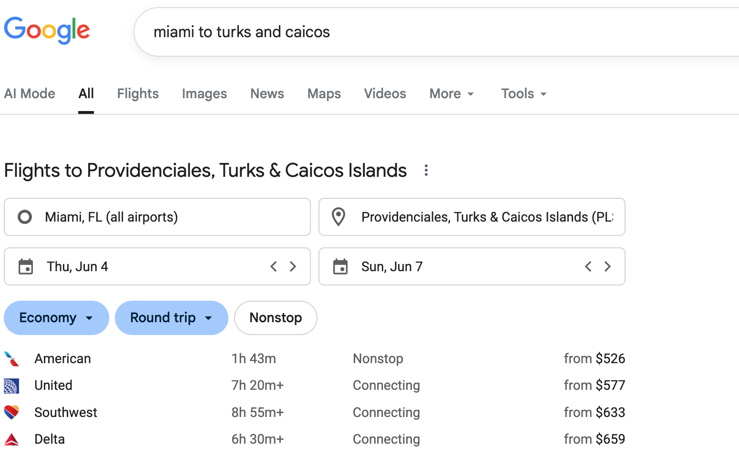

Transportation Miami to T & C

Slide 9
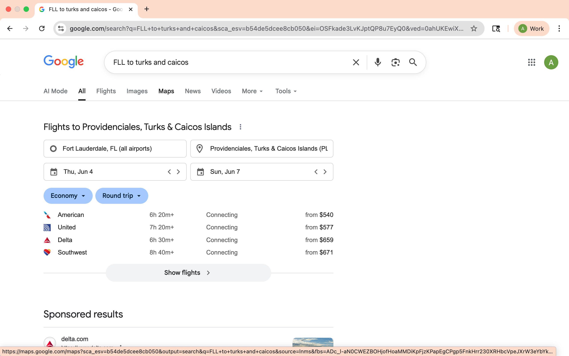
Transportation FLL to T&C

