Slide 1
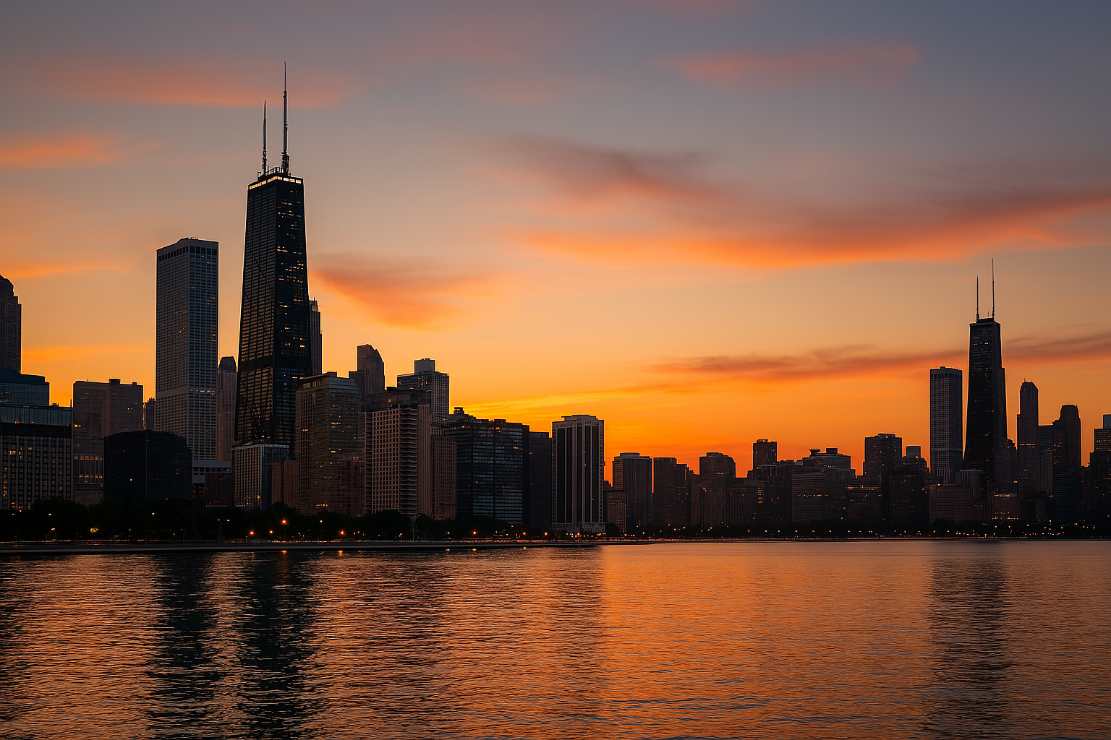
Site Proposal
45th Glades Central High School Class of 1982 Reunion
Chicago, Illinois
July 23–25, 2027

Slide 2
Event Overview
• 45-Year Class Reunion
• Downtown Chicago Host City
• 3 Day Weekend Celebration

Slide 3
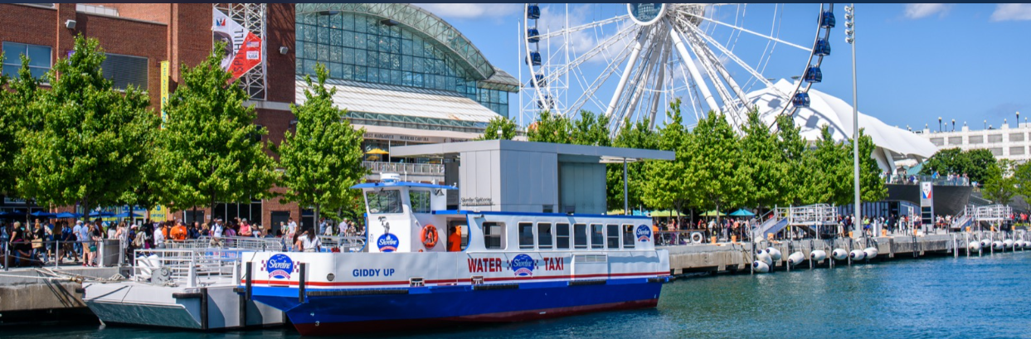
Top Attraction: Navy Pier
Iconic waterfront destination
Dining, sightseeing & skyline views

Slide 4
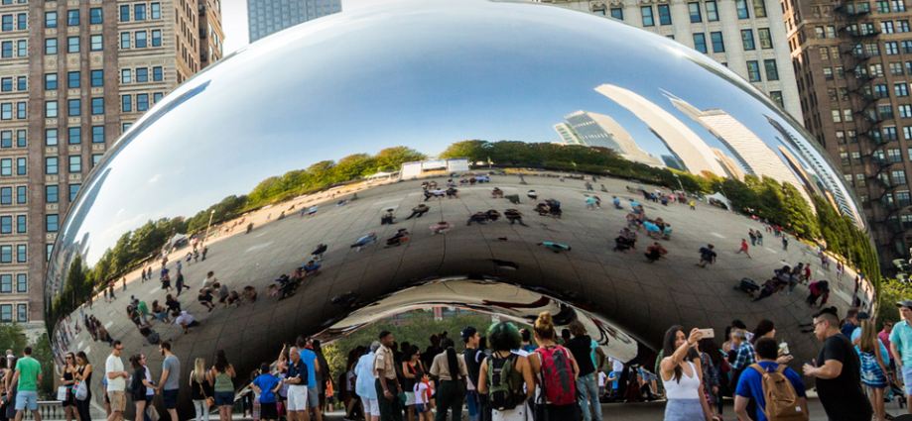
Top Attraction: Millennium Park
Home of Cloud Gate (The Bean)
Free, walkable downtown landmark

Slide 5
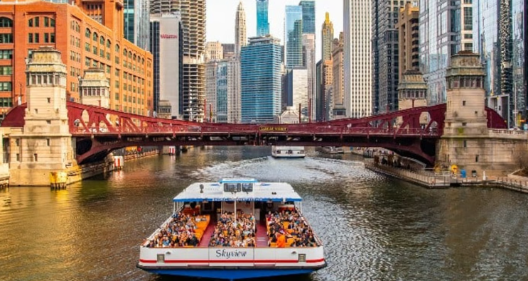
Top Attraction: Architecture River Cruise
Top-rated Chicago experience
Guided skyline boat tour

Slide 6
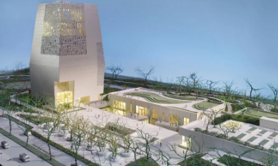
Barack Obama Presidential Center
Located in Jackson Park
Museum, library & cultural campus
Opens June 19, 2026

Slide 7
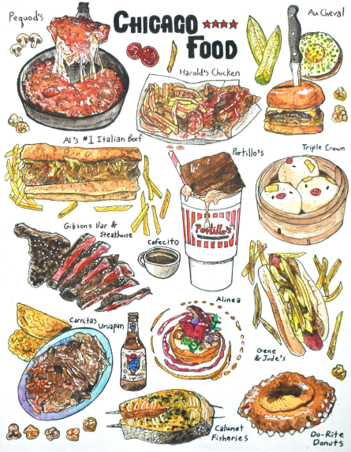
Chicago Food
Deep Dish Pizza
Italian Beef Sandwich
Chicago-Style Hot Dog
Garrett Popcorn
Brownies
Harold’s Chicken
Rainbow Cone

Slide 8

Chicago Food (Continued)

Slide 9
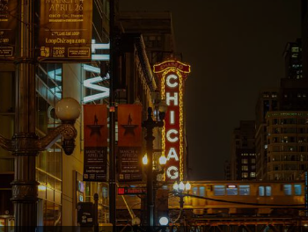
Entertainment & Nightlife
Live jazz & blues
Rooftop lounges
Comedy & theaters

Slide 10
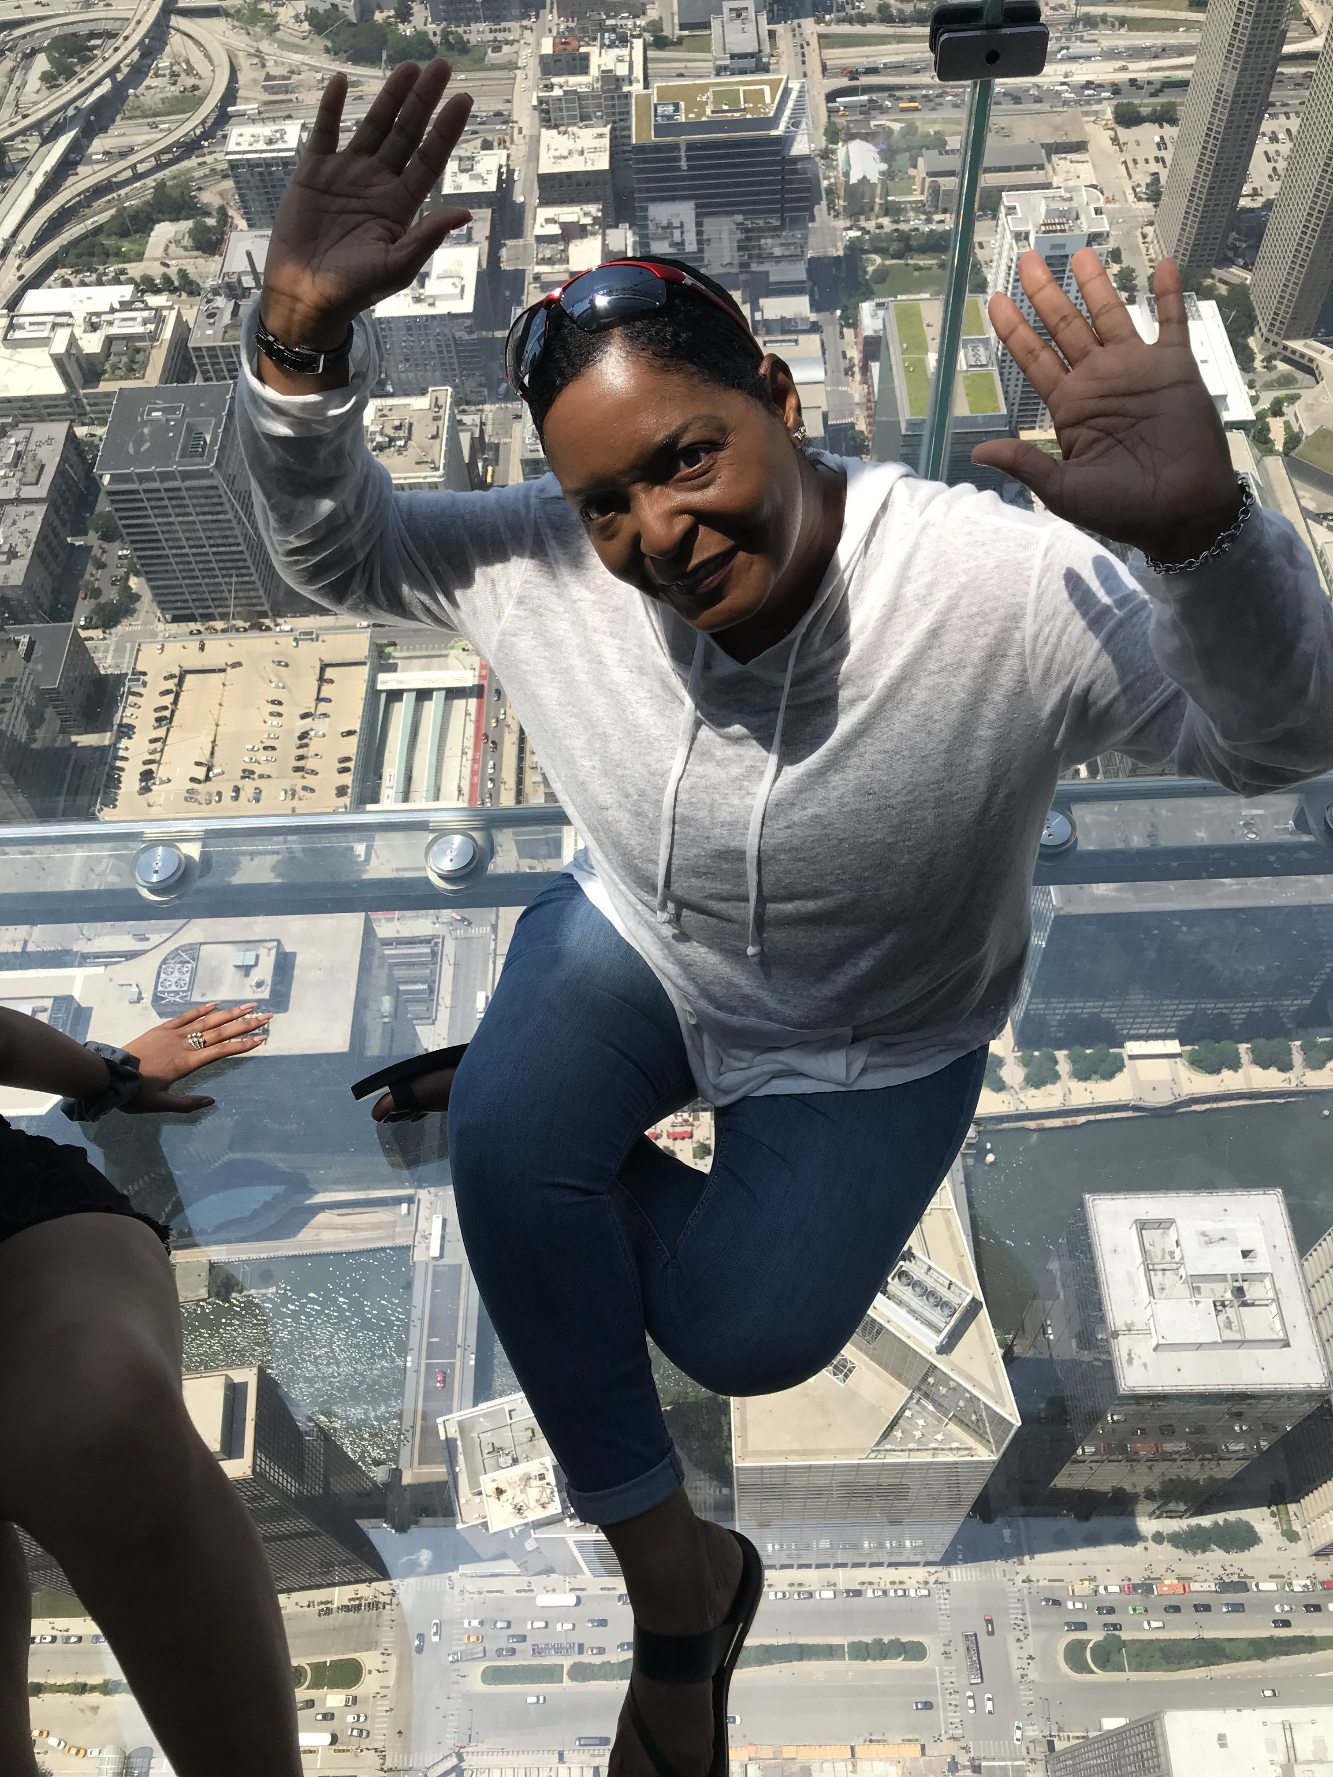
Tours & Activities
Skydeck Chicago
Architecture tours
Museum campus visits
Boat & walking tours
Chicago City Pass
Hope on, Hope off Bus tours

Slide 11

Hotel Rates – Downtown Chicago
Mid-range hotels: $150–$300/night
Upscale hotels: $300–$450+/night
Group discounts available

Slide 12
Hotels

Slide 13
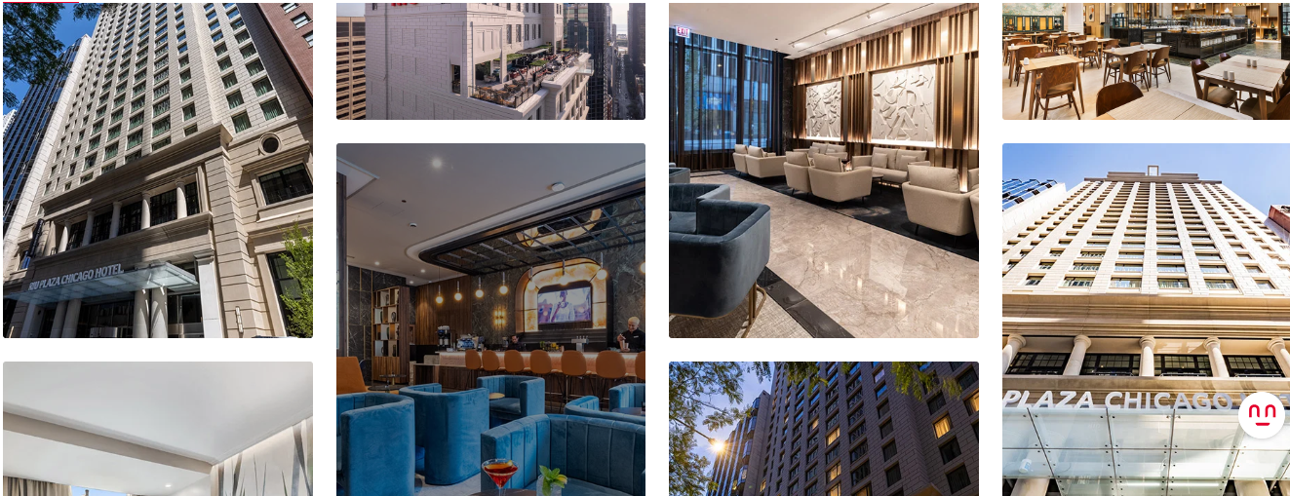
Hotels

Slide 14
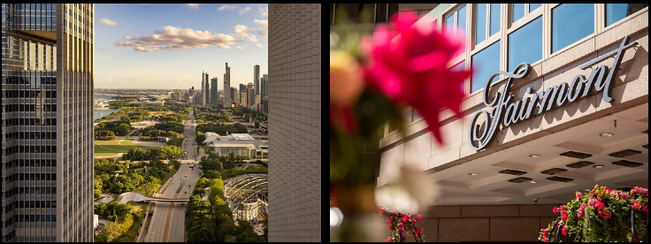
Hotels

Slide 15
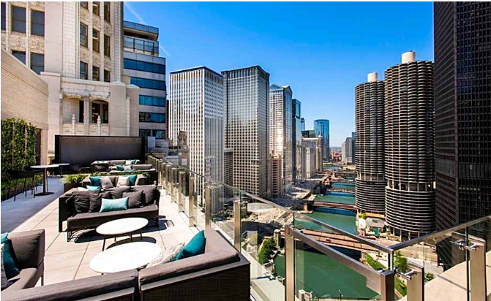
Hotels

Slide 16
Why Chicago?
Central location
World-class attractions
Great food & nightlife
Memorable milestone destination

