Slide 1
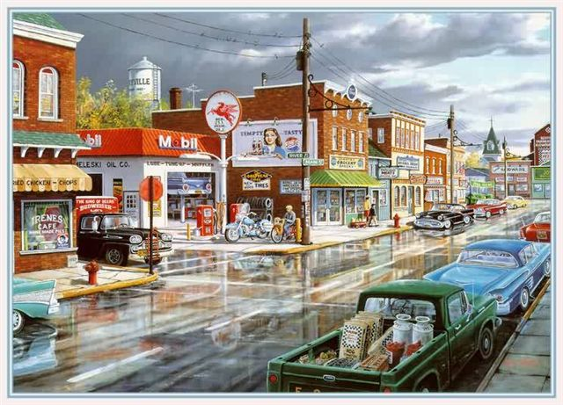

Slide 2
Long ago and far away, in a land that time forgot, Before the days of Dylan, or the dawn of Camelot. There lived a race of innocents, and they were you and me,

Slide 3
For Ike was in the White House in that land where we were born, Where navels were for oranges, and Peyton Place was porn.

Slide 4
We learned to gut a muffler, we washed our hair at dawn, We spread our crinolines to dry in circles on the lawn.

Slide 5
We longed for love and romance, and waited for our Prince, And Eddie Fisher married Liz, and no one's seen him since.

Slide 6
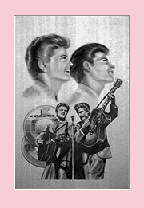
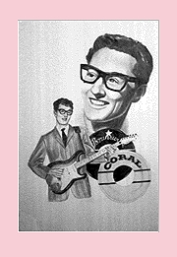
We danced to 'Little Darlin,' and sang to 'Stagger Lee' And cried for Buddy Holly in the Land That Made Me, Me.

Slide 7
Only girls wore earrings then, and 3 was one too many, And only boys wore flat-top cuts, except for Jean McKinney.

Slide 8
And only in our wildest dreams did we expect to see A boy named George with Lipstick, in the Land That Made Me, Me.

Slide 9
We fell for Frankie Avalon, Annette was oh, so nice, And when they made a movie, they never made it twice.

Slide 10
We didn't have a Star Trek Five, or Psycho Two and Three, Or Rocky-Rambo Twenty in the Land That Made Me, Me.

Slide 11
Miss Kitty had a heart of gold, and Chester had a limp, And Reagan was a Democrat whose co-star was a chimp.

Slide 12
We had a Mr. Wizard, but not a Mr. T, And Oprah couldn't talk yet, in the Land That Made Me, Me. We had our share of heroes, we never thought they'd go, At least not Bobby Darin, or Marilyn Monroe.

Slide 13
For youth was still eternal, and life was yet to be, And Elvis was forever in the Land That Made Me, Me.

Slide 14
We'd never seen the rock band that was Grateful to be Dead, And Airplanes weren't named Jefferson , and Zeppelins were not Led.

Slide 15
And Beatles lived in gardens then, and Monkees lived in trees, Madonna was Mary in the Land That Made Me, Me.

Slide 16
We'd never heard of microwaves, or telephones in cars, And babies might be bottle-fed, but they weren't grown in jars.

Slide 17
And pumping iron got wrinkles out, and 'gay' meant fancy-free, And dorms were never co-ed in the Land That Made Me, Me.

Slide 18
We hadn't seen enough of jets to talk about the lag, And microchips were what was left at the bottom of the bag.

Slide 19
And Hardware was a box of nails, and bytes came from a flea, And rocket ships were fiction in the Land That Made Me, Me.

Slide 20
Buicks came with portholes, and side shows came with freaks, And bathing suits came big enough to cover both your cheeks.

Slide 21
And Coke came just in bottles, and skirts below the knee, And Castro came to power near the Land That Made Me, Me.

Slide 22
We had no Crest with Fluoride, we had no Hill Street Blues, We had no patterned pantyhose or Lipton herbal tea Or prime-time ads for those dysfunctions
in the Land That Made Me, Me.

Slide 23
There were no golden arches, no Perrier to chill, And fish were not called Wanda, and cats were not called Bill.

Slide 24
And middle-aged was 35 and old was forty-three, And ancient were our parents in the Land That Made Me, Me.

Slide 25
But all things have a season, or so we've heard them say, And now instead of Maybelline we swear by Retin-A. They send us invitations to join AARP, We've come a long way, baby, from the Land That Made Me, Me.

Slide 26
So now we face a brave new world in slightly larger jeans, And wonder why they're using smaller print in magazines. And we tell our children's children of the way it used to be, Long ago and far away in the Land That Made Me, Me.

